Slide 1
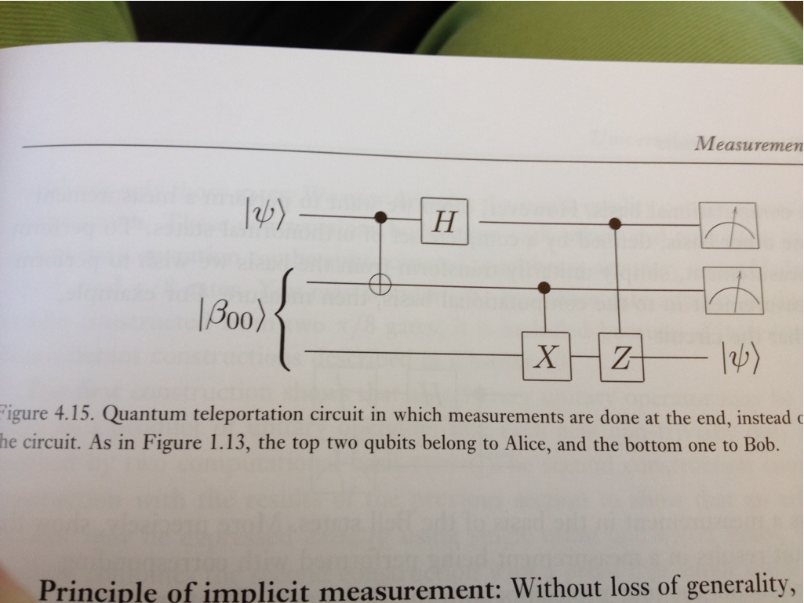
Quantum Lecture 6.9 Recap of Teleportation

Slide 2
Agenda for Lecture 6.9 Recap of Teleportation
8:30 – 9:00 RECAP of Bell states
9:15 – 10:00 TP1 Alice and Bob Share an Entangled Pair of Particles
10:15 – 11:00 TP2 Alice Applies a CNOT Gate
11:00 – 11:45 TP3 Alice Applies a Hadamard Gate
11:45 – 12:30 Lunch
12:30 – 13:15 TP4 Alice Measures Her Pair
13:30 – 14:00 TP5 Alice Contacts Bob on a Classical Communications
Channel and Tells Him Her Measurement Result

Slide 3
8:30 – 9:00 RECAP
Review of the 4 Bell states from the board
Video 6.2 Bell-State
X, Y and Z gates, what are they actual doing and how can the be used
Notes:
The Bell states are four specific maximally entangled quantum states of two qubits. They are in a superposition of 0 and 1--that is, a linear combination of the two states. Their entanglement means the following:
The qubit held by Alice (subscript "A") can be 0 as well as 1. If Alice measured her qubit in the standard basis, the outcome would be perfectly random, either possibility 0 or 1 having probability 1/2. But if Bob (subscript "B") then measured his qubit, the outcome would be the same as the one Alice got. So, if Bob measured, he would also get a random outcome on first sight, but if Alice and Bob communicated, they would find out that, although their outcomes seemed random, they are perfectly correlated.
This perfect correlation at a distance is special: maybe the two particles "agreed" in advance, when the pair was created (before the qubits were separated), which outcome they would show in case of a measurement.
Hence, following Einstein, Podolsky, and Rosen in 1935 in their famous "EPR paper", there is something missing in the description of the qubit pair given above—namely this "agreement", called more formally a hidden variable.
Bell basis
In his famous paper of 1964, John S. Bell showed by simple probability theory arguments that these correlations (the one for the 0,1 basis and the one for the +,- basis) cannot both be made perfect by the use of any "pre-agreement" stored in some hidden variables—but that quantum mechanics predicts perfect correlations. In a more formal and refined formulation known as the Bell-CHSH inequality, it is shown that a certain correlation measure cannot exceed the value 2 if one assumes that physics respects the constraints of local "hidden variable" theory (a sort of common-sense formulation of how information is conveyed), but certain systems permitted in quantum mechanics can attain values as high as {\displaystyle 2{\sqrt {2}}}2{\sqrt {2}}. Thus, quantum theory violates the Bell inequality and the idea of local "hidden variables."
Four specific two-qubit states with the maximal value of {\displaystyle 2{\sqrt {2}}}2{\sqrt {2}} are designated as "Bell states". They are known as the four maximally entangled two-qubit Bell states, and they form a maximally entangled basis, known as the Bell basis, of the four-dimensional Hilbert space for two qubits: [2]

Slide 4
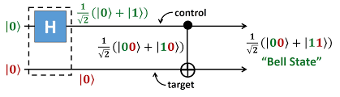
A grahical presentation on how to realize a ”Bell state”
Show a grahical presentation on how a entangled state will be by a Hadamard and a CNOT gate.

Slide 5
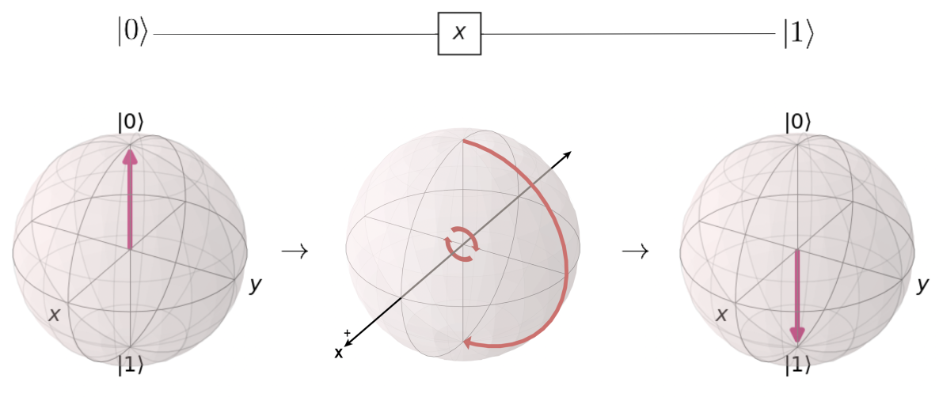
Exercise recaps
What is measurement about
What does the X,Y and Z do as OPERATORS

Slide 6
Pauli X-gate

Slide 7
Pauli Z-gate

Slide 8
Pauli Y-gate

Slide 9
9:15 – 10:00 Intro to Teleportation
. Let’s denote the state that Alice wants to send Bob by |χ>. The state is a qubit:
|χ> = α|0> + β|1> (10.1)
Notes:
Anyone who has read science fiction or watched it on television is familiar with
teleportation—a device or process by which people can jet around the galaxy. The
basic idea is that you get scanned somehow, turned into energy, then beamed to
where you want to go and rematerialized.
While such a procedure is likely to remain in the realm of science fiction,
quantum mechanics does allow us to do something almost as magical. It allows
us to send a quantum state from one place to another without that state traversing
the space in between. Good thing Einstein wasn’t around to hear about this. If
entanglement itself made him feel “spooky,” then teleportation is sure to be making
him turn over in his grave.
While teleportation seems to work almost by magic Einstein can breathe a
sigh of relief because special relativity seems to step in to prevent faster than light
communication. To see how this works, let’s go through the basic formalism. The
task at hand is that Alice wants to transmit an unknown quantum state to Bob. Let’s
denote the state that Alice wants to send Bob by |χ. The state is a qubit:
|χ = α|0 + β|1 (10.1)
By saying the state is unknown, we are saying we don’t necessarily know what α and
β are. All we assume is that the state is normalized, so |α|2 +|β|2 =1. Teleportation
takes place in a series of steps. We begin by creating an entangled EPR pair.

Slide 10
9:15 – 10:00 Teleportation Step 1 Alice and Bob Share an Entangled Pair of Particles
Notes:
Here we’ve decided that the first member of the pair belongs to Alice and the second
member of the pair belongs to Bob. Now Alice and Bob physically separate. Alice
decides that she wants to send the state (10.1) to Bob. She can do it by letting it
interact with her member of the EPR pair in (10.2).

Slide 11
10:15 – 11:00 Teleportation Step 2 Alice Applies a CNOT Gate

Slide 12
TP2 continued

Slide 13
11:15 – 11:45 Teleportation Step 3 Alice Applies a Hadamard Gate

Slide 14
11:45 – 12:30 Lunch &/or Free for the rest of the day

Slide 15
12:30 – 13:15 Teleportation Step 4 Alice Measures Her Pair
Notes:
The next step in the process is that Alice makes a measurement on both qubits in
her possession. First, let’s rewrite the state so that the state is written in terms of the
possible measurement results on the first two qubits. These possible measurement
228 APPLICATIONS OF ENTANGLEMENT: TELEPORTATION AND SUPERDENSE CODING
results are |00, | 01, | 10, and |11. So we can write (10.8) as

Slide 16
13:30 – 14:00 Teleportation Step 5 Alice Contacts Bob on a Classical Communications Channel and Tells Him Her Measurement Result
• Performs local quantum mechanical (local unitaries) operations on their respective
states.
• Uses classical communication to communicate measurement results.
If classical communications is not used, then the state will appear totally random
to Bob.
BUT hoow will You do this for the time being programmatabibly ?
Notes:
At this stage of the game special relativity surprisingly enters the game. Alice
has to somehow tell Bob her measurement result, and she has to do it using a
classical communications channel—a telephone, email message, radio wave, or
something—some mechanism governed by the speed of light limit. It’s this necessary
step that prevents Alice and Bob from faster than light communication. But
security is maintained—Alice just calls Bob and for instances, says she got 01, then
Bob applies his X gate to obtain the state Alice wanted to send to Bob. Nothing
about that state is communicated over the classical channel—Bob can obtain it
because they shared an entangled EPR pair of particles.
The lesson here is that quantum information based communication can be
characterized by two key aspects—local operations and classical communications
(LOCC). That is, each party has two tasks:
• Performs local quantum mechanical (local unitaries) operations on their respective
states.
• Uses classical communication to communicate measurement results.
If classical communications is not used, then the state will appear totally random
to Bob.

